Slide 1


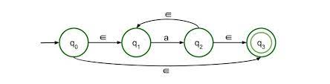


NFA –ε to DFA

Slide 2


NFA with ε to DFA
Step 1: We will take the ε-closure for the starting state of NFA as a starting state of DFA.
Step 2: Find the states for each input symbol that can be traversed from the present. That means the union of transition value and their closures for each state of NFA present in the current state of DFA.
Step 3: If we found a new state, take it as current state and repeat step 2.
Step 4: Repeat Step 2 and Step 3 until there is no new state present in the transition table of DFA.
Step 5: Mark the states of DFA as a final state which contains the final state of NFA.
3

Slide 3
NFA with ε to DFA
3

Slide 4
NFA with ε to DFA
3

Slide 5
NFA with ε to DFA
3

Slide 6
NFA with ε to DFA
3

Slide 7
NFA with ε to DFA
3

Slide 8
NFA with ε to DFA
3

Slide 9
NFA with ε to DFA
3

